Slide 1
Auto Encoders
Introduction
Architecture
Types
Implementation
Applications

Slide 2
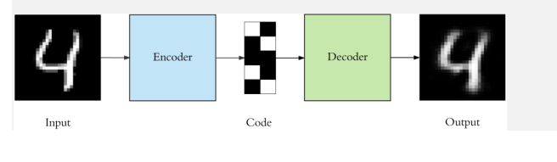
1. INTRODUCTION
Auto encoders are a specific type of feedforward neural networks where the input is the same as the output.
They compress the input into a lower-dimensional code and then reconstruct the output from this representation.
The code is a compact “summary” or “compression” of the input, also called the latent space representation.
An auto encoder consists of 3 components: encoder, code and decoder. The encoder compresses the input and produces the code, the decoder then reconstructs the input only using this code.

Slide 3
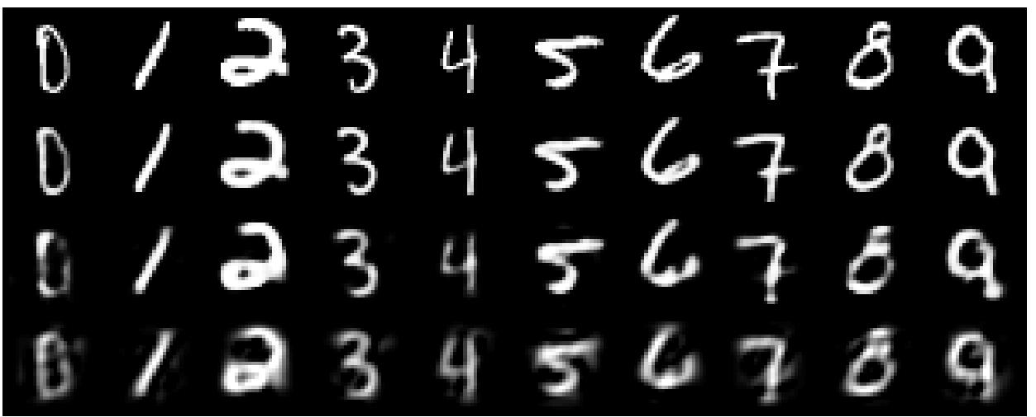
real data
30-D deep auto
30-D PCA

Slide 4
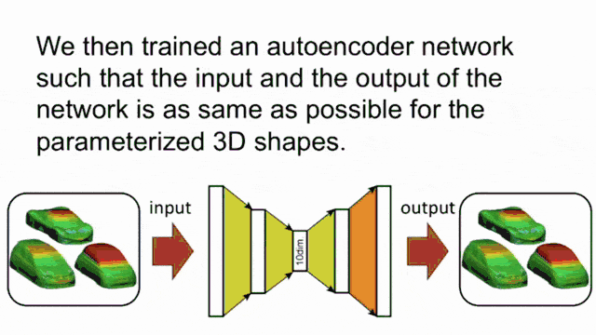

Slide 5
Introduction
To build an autoencoder we need 3 things: an encoding method, decoding method, and a loss function to compare the output with the target.
Autoencoders are mainly a dimensionality reduction (or compression) algorithm with a couple of important properties: •
Data-specific: Autoencoders are only able to meaningfuly compress data similar to what they have been trained on. Since they learn features specific for the given training data, they are different than a standard data compression algorithm like gzip. So we can’t expect an autoencoder trained on handwritten digits to compress landscape photos.
Lossy: The output of the autoencoder will not be exactly the same as the input, it will be a close but degraded representation. If you want lossless compression they are not the way to go.

Slide 6
Introduction
Unsupervised: To train an autoencoder, just throw the raw input data at it. Autoencoders are considered an unsupervised learning technique since they don’t need explicit labels to train on. But to be more precise they are self-supervised because they generate their own labels from the training data.

Slide 7
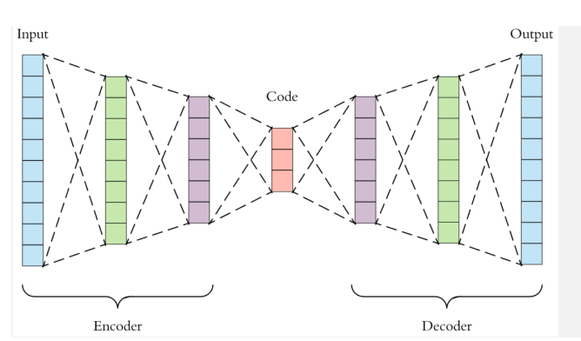
2. Architecture
Both the encoder and decoder are fully-connected feedforward neural networks
Code is a single layer of an ANN with the dimensionality of our choice.
The number of nodes in the code layer (code size) is a hyperparameter that we set before training the autoencoder.

Slide 8
2. Architecture….
First the input passes through the encoder, which is a fully-connected ANN, to produce the code.
The decoder, which has the similar ANN structure, then produces the output only using the code.
The goal is to get an output identical with the input. •
Note that the decoder architecture is the mirror image of the encoder. This is not a requirement but it’s typically the case.
The only requirement is the dimensionality of the input and output needs to be the same.
Anything in the middle can be played with.

Slide 9
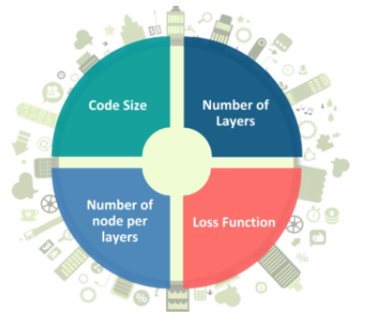
Hyper parameters of Autoencoders

Slide 10
Hyper parameters of Autoencoders
There are 4 hyperparameters that we need to set before training an autoencoder:
Code size: It represents the number of nodes in the middle layer. Smaller size results in more compression.
Number of layers: The autoencoder can consist of as many layers as we want.
Number of nodes per layer: The number of nodes per layer decreases with each subsequent layer of the encoder, and increases back in the decoder. The decoder is symmetric to the encoder in terms of the layer structure.
Loss function: We either use mean squared error or binary cross-entropy. If the input values are in the range [0, 1] then we typically use cross-entropy, otherwise, we use the mean squared error.
Autoencoders are trained the same way as ANNs via backpropagation

Slide 11
Types of Autoencoders
There are, basically, 7 types of autoencoders:
Denoising autoencoder
Convolutional Autoencoder
Others -
Sparse Autoencoder
Deep Autoencoder
Contractive Autoencoder
Undercomplete Autoencoder
Variational Autoencoder

Slide 12
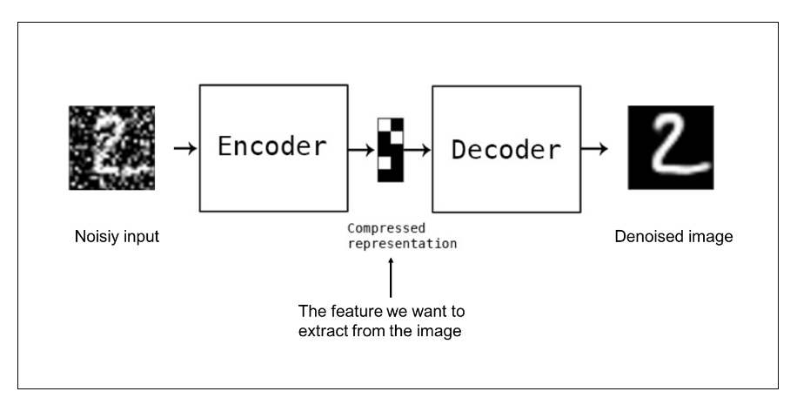
Types of Autoencoders
Denoising autoencoders
create a corrupted copy of the input by introducing some noise.
This helps to avoid the autoencoders to copy the input to the output without learning features about the data.
These autoencoders take a partially corrupted input while training to recover the original undistorted input.

Slide 13
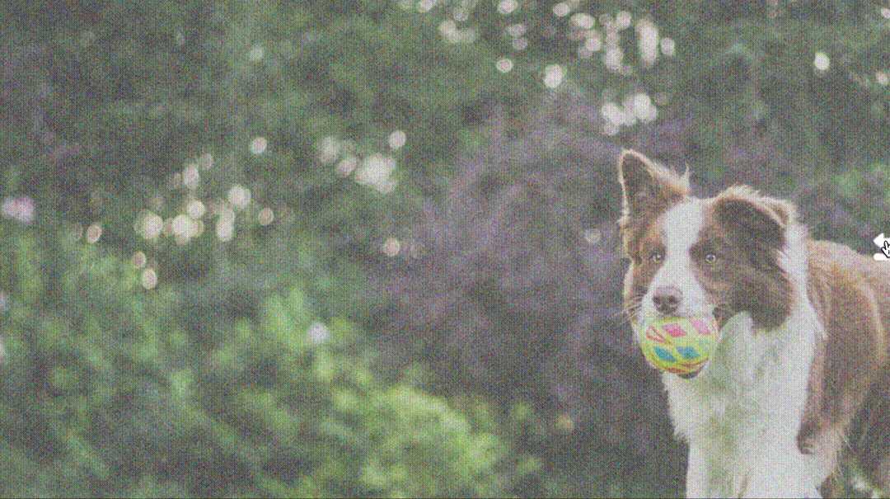

Slide 14
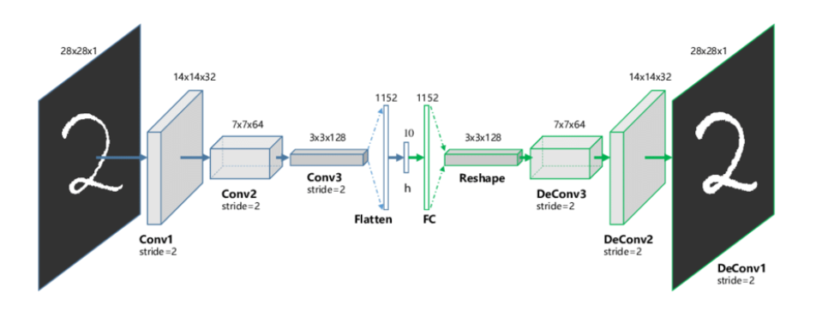
2. Convolutional Autoencoders

Slide 15
2. Convolutional Autoencoders…
Convolutional Autoencoder is a variant of Convolutional Neural Networks that are used as the tools for unsupervised learning of convolution filters.
They are generally applied in the task of image reconstruction to minimize reconstruction errors by learning the optimal filters.
Once they are trained in this task, they can be applied to any input in order to extract features.
Convolutional Autoencoders are general-purpose feature extractors differently from general autoencoders that completely ignore the 2D image structure.

Slide 16
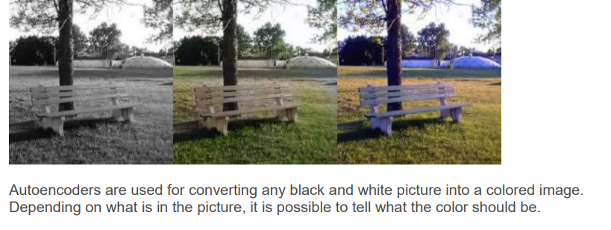
3. Applications
Image Coloring

Slide 17
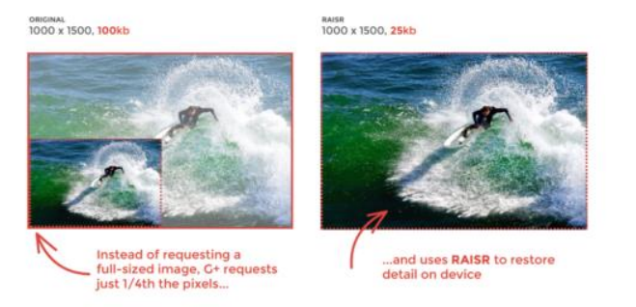
Applications…
Dimensionality reduction
The reconstructed image is the same as our input but with reduced dimensions. It helps in providing the similar image with a reduced pixel value.

Slide 18
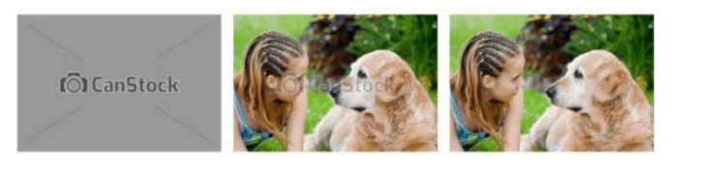
Applications…
Watermark Removal
It is also used for removing watermarks from images or to remove any object while filming a video or a movie.

Slide 19
Generative Modeling?
Generative modeling
is an unsupervised machine learning task.
it involves automatically discovering and learning the regularities or patterns in input data
the model learnt, can be used to generate or output new examples that plausibly could have been drawn from the original dataset
Generative Adversarial Networks, or GANs for short, are an approach to generative modeling using deep learning methods, such as convolutional neural networks.
It was developed and introduced by Ian J. Goodfellow in 2014
The GAN architecture involves two sub-models: a generator model for generating new examples and a discriminator model for classifying whether generated examples are real from the domain, or fake, generated by the generator model.

Slide 20
GAN break it into separate three parts
Generative – To learn a generative model, which describes how data is generated in terms of a probabilistic model. In simple words, it explains how data is generated visually.
Adversarial – The training of the model is done in an adversarial setting.
Networks – use deep neural networks for training purposes.
Why GANs was Developed?
Machine learning algorithms and neural networks can easily be fooled to misclassify things by adding some amount of noise to data.
After adding some amount of noise, the chances of misclassifying the images increase. Hence the small rise that, is it possible to implement something that neural networks can start visualizing new patterns like sample train data.
Thus GANs were built that generate new fake results similar to the original.

Slide 21
Generative Adversarial Networks (GANs)
The two models are trained together in a zero-sum game, adversarial, until the discriminator model is fooled about half the time, meaning the generator model is generating plausible examples.
GANs are able to generate realistic examples across a range of problem domains, most notably in image-to-image translation tasks such as translating photos of summer to winter or day to night, and in generating photorealistic photos of objects, scenes, and people that even humans cannot tell are fake.

Slide 22
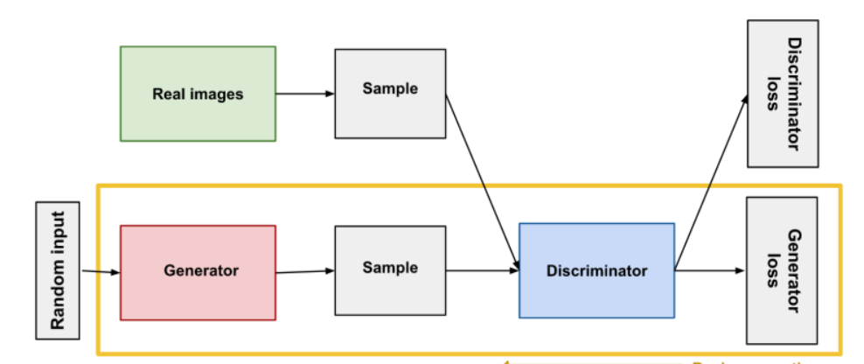
In GANs, there is a generator and a discriminator.
A generator network takes a random normal distribution (z), and outputs a generated sample that’s close to the original distribution.
The Generator generates fake samples of data(be it an image, audio, etc.) and tries to fool the Discriminator.

Slide 23
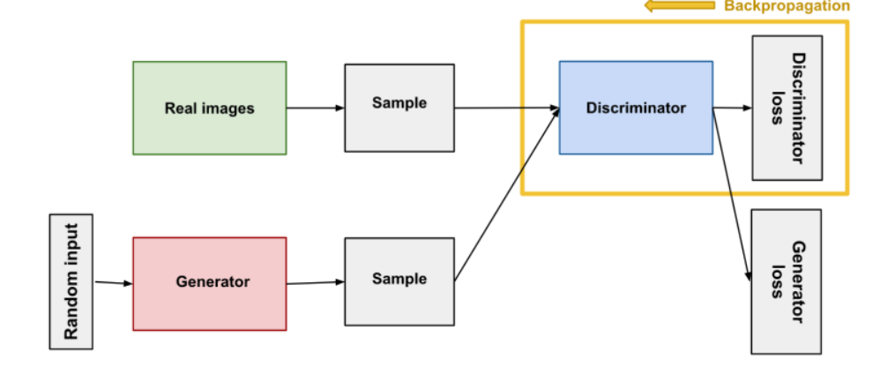
A discriminator tries to evaluate/discriminate the output generated by the generator with the original sample, and outputs a value between 0 and 1. If the value is close to 0, then the generated sample is fake, and if the value is close to 1 then the generated sample is real.

Slide 24
In short, the discriminator’s job is to identify whether the generated sample is real or fake by comparing it with the original sample. The generator’s job is to fool the discriminator by generating samples that are close to the original sample.
The Generator and the Discriminator are both Neural Networks and they both run in competition with each other in the training phase.
The steps are repeated several times , and the Generator and Discriminator get better and better in their respective jobs after each repetition

Slide 25
A random normal distribution is fed into the generator. The generator then outputs a random distribution, since it doesn’t have a reference point.
Meanwhile, an actual sample, or ground truth, is fed into the discriminator.
The discriminator learns the distribution of the actual sample.
When the generated sample from the generator is fed into the discriminator, it evaluates the distribution.
If the distribution of the generated sample is close to the original sample, then the discriminator outputs a value close to ‘1’ = real.
If both the distribution doesn’t match or they aren’t even close to each other, then the discriminator outputs a value close to ‘0’ = fake.

Slide 26
The discriminator measures the distance between the distribution of the data generated and the distribution of the real data using a loss function.
Both the generator and the discriminator have their own loss functions. The generator tries to minimize the loss function while the discriminator tries to maximize.

Slide 27
Training the Discriminator
Part 1: When the Discriminator is trained, the Generator is idle. In this phase, the network is only forward propagated and no back-propagation is done.
The Discriminator is trained on real data for n epochs, and checked if it can correctly predict them as real.
Also, in this phase, the Discriminator is also trained on the fake generated data from the Generator and checked if it can correctly predict them as fake.

Slide 28
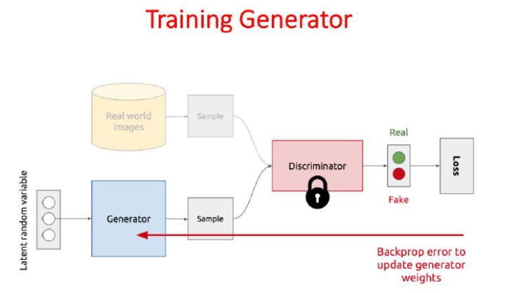
Training a GAN has two parts:
Part 2: When the Generator is trained, the Discriminator is idle.
After the Discriminator is trained by the generated fake data of the Generator, we can get its predictions and use these results for training the Generator and get better from the previous state to try and fool the Discriminator.
The above method is repeated for a few epochs and then manually check the fake data if it seems genuine. If it seems acceptable, then the training is stopped, otherwise, its allowed to continue for few more epochs.

Slide 29
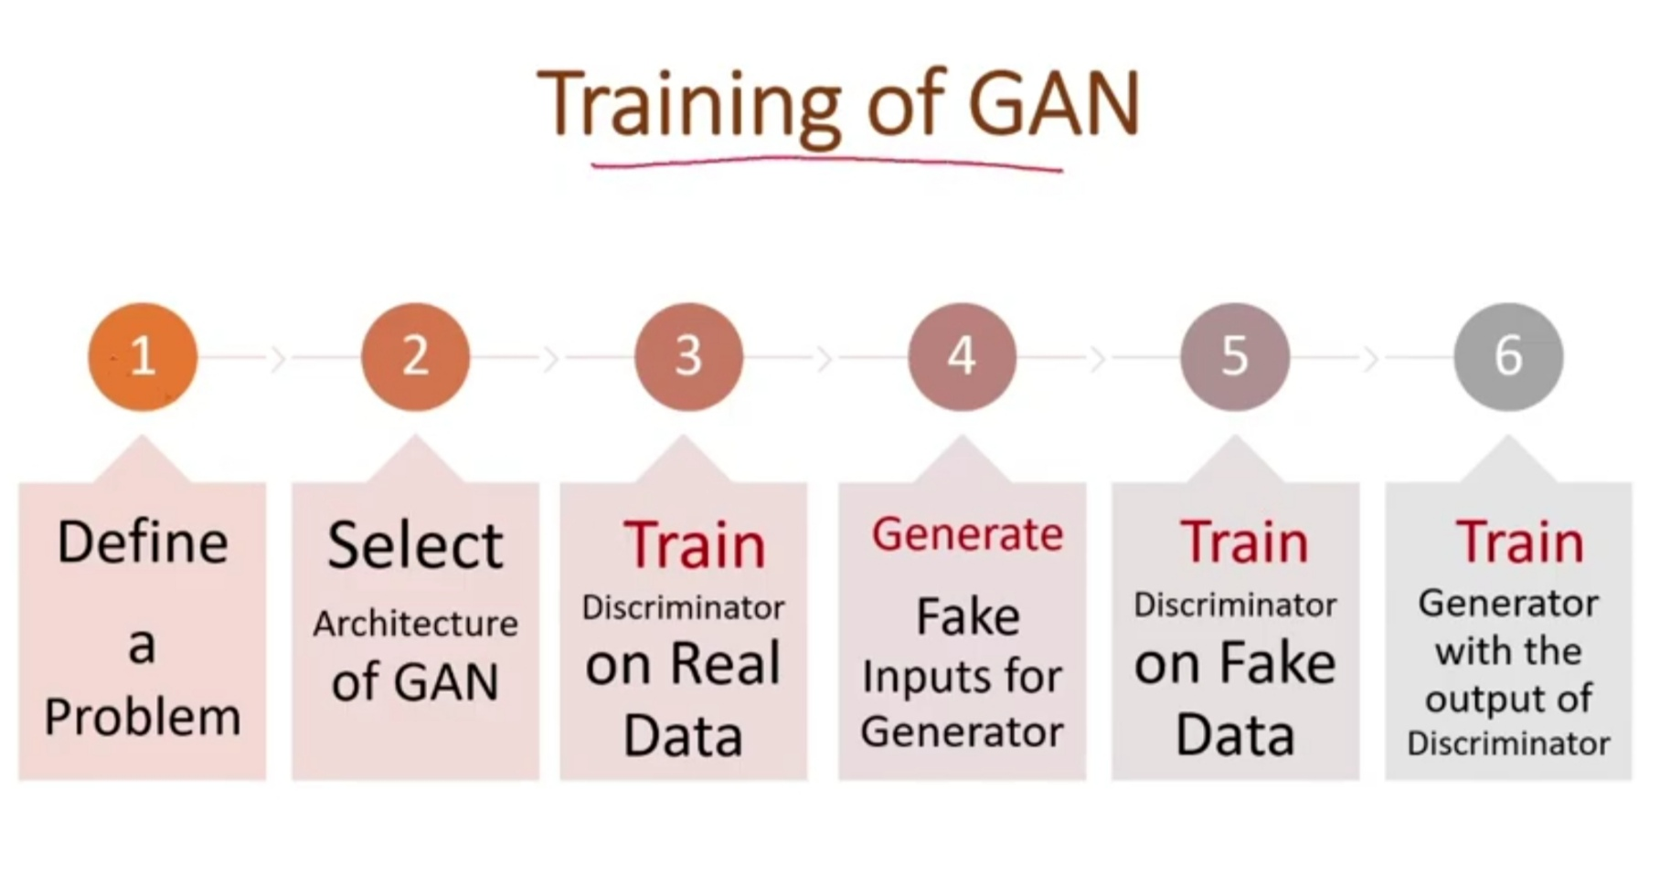
Training & Prediction of Generative Adversarial Networks (GANs)

Slide 30
Different Types of Generative Adversarial Networks (GANs)
1) DC GAN – It is a Deep convolutional GAN. It is one of the most used, powerful, and successful types of GAN architecture. It is implemented with help of ConvNets in place of a Multi-layered perceptron. The ConvNets use a convolutional stride and are built without max pooling and layers in this network are not completely connected.
2) Conditional GAN and Unconditional GAN (CGAN) – Conditional GAN is deep learning neural network in which some additional parameters are used. Labels are also put in inputs of Discriminator in order to help the discriminator to classify the input correctly and not easily full by the generator.
3) Least Square GAN(LSGAN) – It is a type of GAN that adopts the least-square loss function for the discriminator. Minimizing the objective function of LSGAN results in minimizing the Pearson divergence

Slide 31
4) Auxilary Classifier GAN(ACGAN) – It is the same as CGAN and an advanced version of it. It says that the Discriminator should not only classify the image as real or fake but should also provide the source or class label of the input image.
5) Dual Video Discriminator GAN – DVD-GAN is a generative adversarial network for video generation built upon the BigGAN architecture. DVD-GAN uses two discriminators: a Spatial Discriminator and a Temporal Discriminator.
6) SRGAN – Its main function is to transform low resolution to high resolution known as Domain Transformation.
7) Cycle GAN
It is released in 2017 which performs the task of Image Translation. Suppose we have trained it on a horse image dataset and we can translate it into zebra images.
8) Info GAN – Advance version of GAN which is capable to learn to disentangle representation in an unsupervised learning approach.

Slide 32
The GANs are formulated as a minimax game, where the Discriminator is trying to maximize its reward V(D, G) and the Generator is trying to minimize the Discriminator’s reward or in other words, maximize its loss.
It can be mathematically formulated as
where, G = Generator D = Discriminator Pdata(x) = distribution of real data P(z) = distribution of generator x = sample from Pdata(x) z = sample from P(z) D(x) = Discriminator network G(z) = Generator network

Slide 33
Challenges Faced by Generative Adversarial Networks (GANs)
The problem of stability between generator and discriminator. We do not want that discriminator should be too strict, we want to be lenient
Problem to determine the positioning of objects. suppose in a picture we have 3 horse and generator have created 6 eyes and 1 horse.
The problem in understanding the global objects – GANs do not understand the global structure or holistic structure which is similar to the problem of perspective. It means sometimes GAN generates an image that is unrealistic and cannot be possible.
A problem in understanding the perspective – It cannot understand the 3-d images and if we train it on such types of images then it will fail to create 3-d images because today GANs are capable to work on 1-d images.

Slide 38
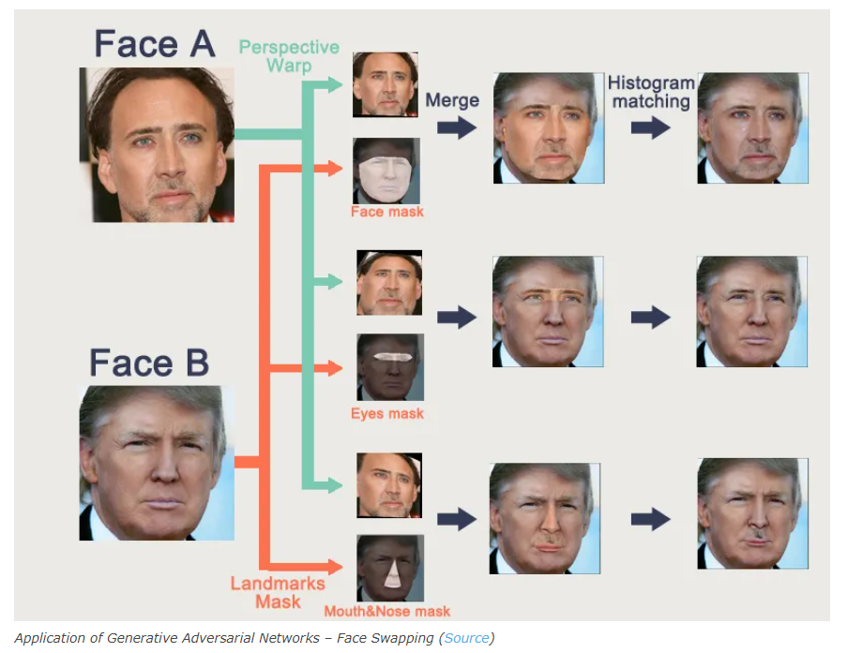
Face Swapping

Slide 39
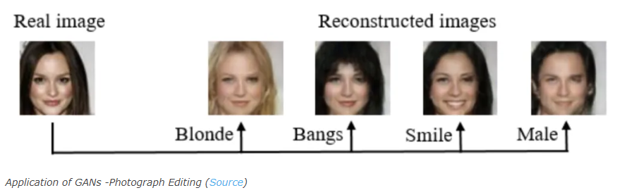
Photo Editing

Slide 40
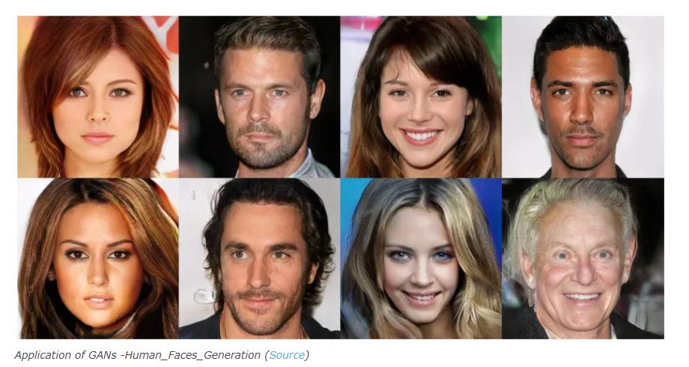
Generate Photographs of human faces

Slide 41
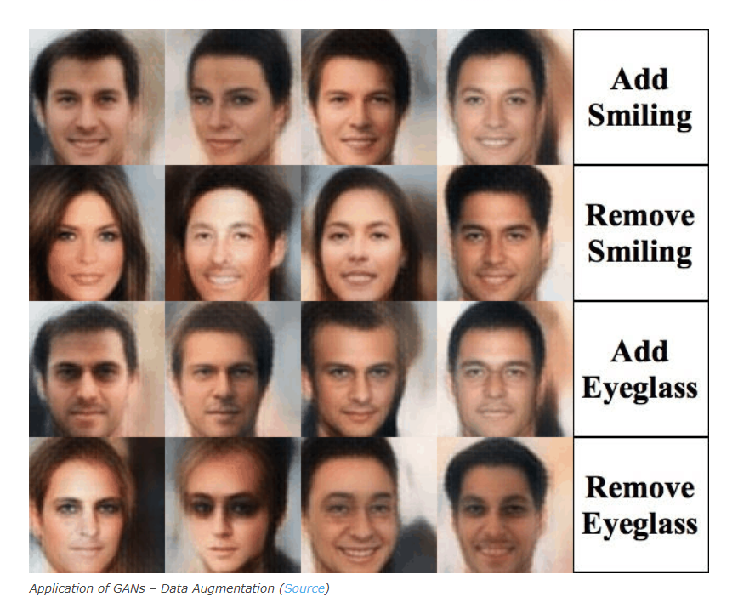
Data Augmentation

Slide 42
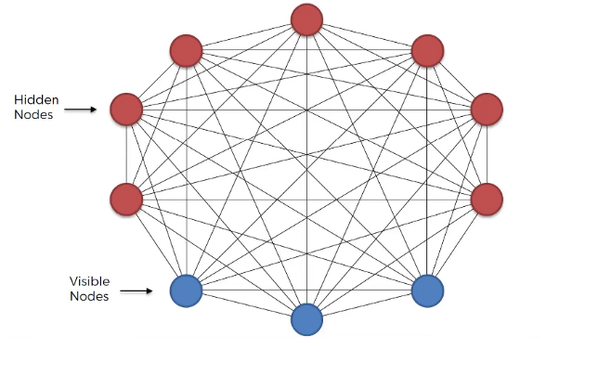
Boltzmann Machine
Boltzmann Machine is a generative unsupervised model, which involves learning a probability distribution from an original dataset and using it to make inferences about never before seen data.
Boltzmann Machine has an input layer (also referred to as the visible layer) and one or several hidden layers (also referred to as the hidden layer).

Slide 43
Boltzmann Machine uses neural networks with neurons that are connected not only to other neurons in other layers but also to neurons within the same layer.
Everything is connected to everything. Connections are bidirectional, visible neurons connected to each other and hidden neurons also connected to each other
Boltzmann Machine doesn’t expect input data, it generates data. Neurons generate information regardless they are hidden or visible.
For Boltzmann Machine all neurons are the same, it doesn’t discriminate between hidden and visible neurons.

Slide 44
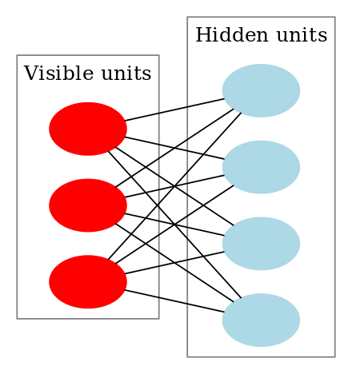
Restricted Boltzmann Machines
RBMs are a two-layered artificial neural network with generative capabilities
RBMs were invented by Geoffrey Hinton and can be used for dimensionality reduction, classification, regression, collaborative filtering, feature learning, and topic modeling
RBMs are a special class of Boltzmann Machines and they are restricted in terms of the connections between the visible and the hidden units.
This means that every node in the visible layer is connected to every node in the hidden layer but no two nodes in the same group are connected to each other.

Slide 45
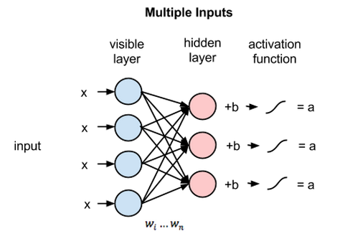
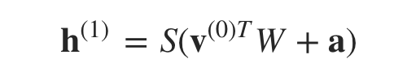
Training RBM
The above image shows the first step in training an RBM with multiple inputs.
The inputs are multiplied by the weights and then added to the bias.
The result is then passed through a sigmoid activation function and the output determines if the hidden state gets activated or not.
• So the equation that we get in this step would be,
• where h(1) and v(0) are the corresponding vectors (column matrices) for the hidden and the visible layers with the superscript as the iteration (v(0) means the input that we provide to the network) and a is the hidden layer bias vector

Slide 46
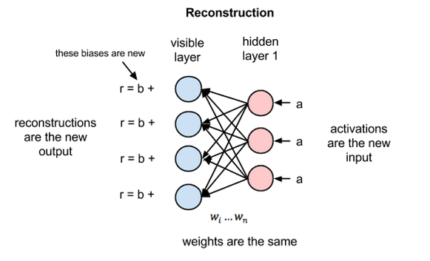
Now this image shows the reverse phase or the reconstruction phase. It is similar to the first pass but in the opposite direction.

Slide 47
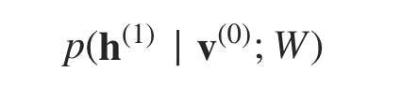
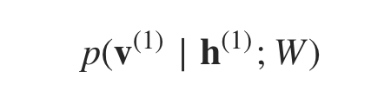
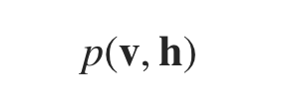
The learning process
Now, the difference v(0)-v(1) can be considered as the reconstruction error that we need to reduce in subsequent steps of the training process.
So the weights are adjusted in each iteration so as to minimize this error and this is what the learning process essentially is.
In the forward pass, we are calculating the probability of output h(1) given the input v(0) and the weights W denoted by:
and in the backward pass, while reconstructing the input, we are calculating the probability of output v(1) given the input h(1) and the weights W denoted by:
The weights used in both the forward and the backward pass are the same. Together, these two conditional probabilities lead us to the joint distribution of inputs and the activations:

